Slide 1
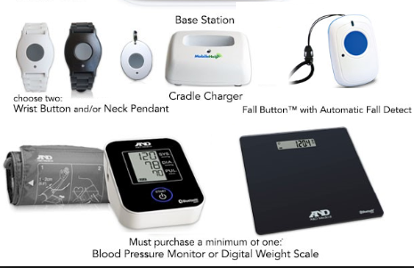

Slide 2
Financial Information of Philips customers:
Dataset has customer’s personal and financial information of all the customers who are using lifeline services. I have just selected some variables related to financial information of customer to see if customer will pay off there loans for different devices and services in future or not.
By Sheryar Mazhar

Slide 3
Data Description:
Data Description:
SeriousDlqin2ys: If a person has defaulted in last two years.(haven’t paid in more than 3 months)
Revolving Utilization: How much credit loan has been utilized.
AGE: Age of the customer
Numberoftime30to90dayslate:if customers payment is late than 30 days and less then 90days.
Debtratio:Debts ratio of customer
Monthly income:Monthly income of customer
Number of open credit linesand loans:credit line of customer
Number of times 90days late:number of times customer paid late then 90days
Number realstateloan:
Numberof time60.89dayspast:Number of times customer has paid later than 60days and less than 89 days

Slide 4
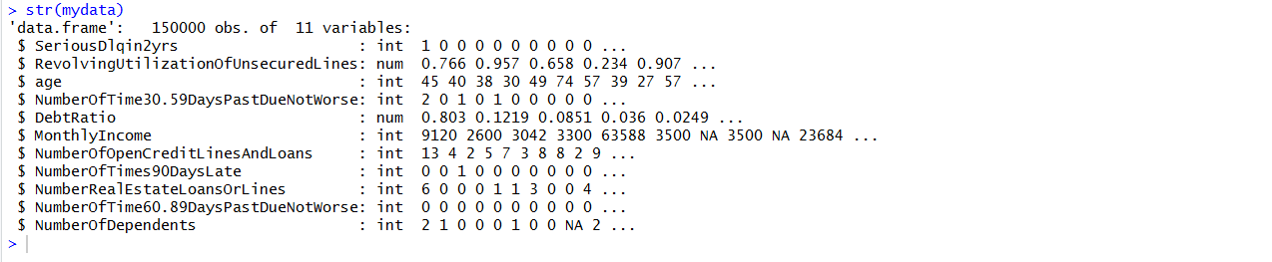
Philips lifeline customer Data :
As we can see most of our data is in type integer with

Slide 5
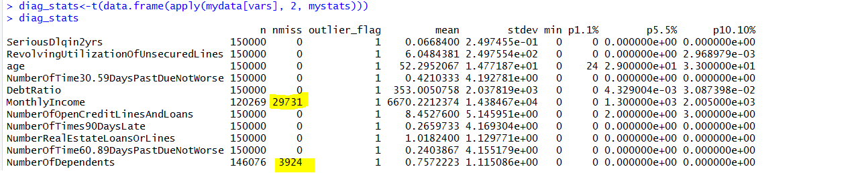
Data cleaning and preperation:
Monthlyincome and number of dependents have most of the missing values
Change outliers by formula +-3*S.d
Changed missing values into mean values

Slide 6
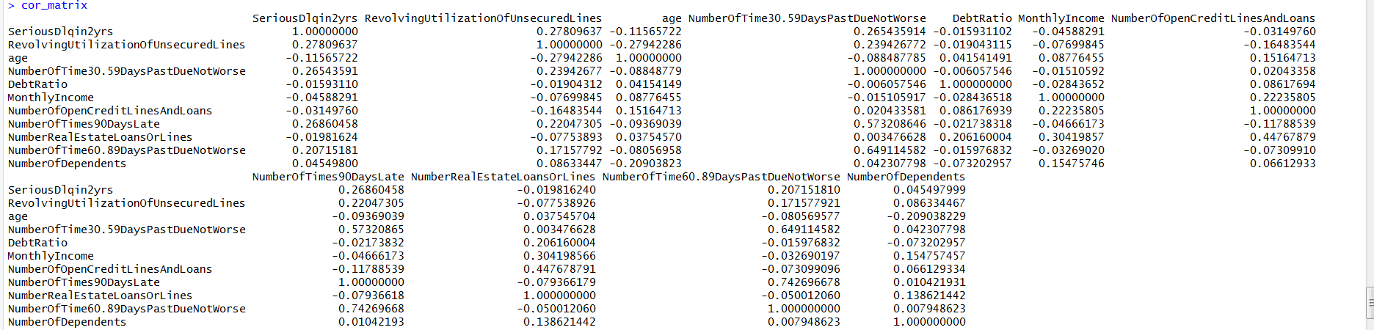
Correlation (cor matrix)of variables:
To see correlation between all variables ran correlation matrix.
Is less than 0.7 which is considered to be week relationship

Slide 7
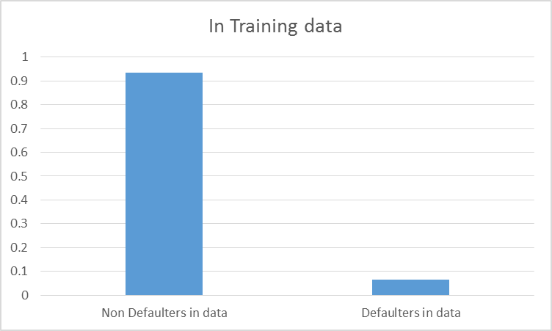

Data distribution:
Distributed data in training and
testing set 70%:30%
We can see distribution is pretty much same.
In all three datasets there are 93.5% of customers are non defaulters where as 6.5% of customers are defaulters.

Slide 8
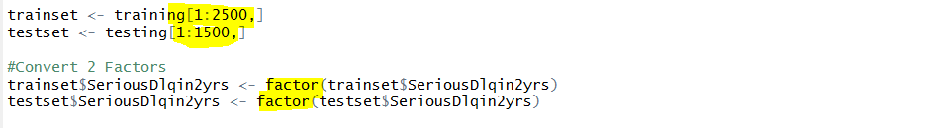
Sub setting of data:
As kNN usually takes a long time for computation in case input data is large so I have decided to Consider only a subset of the data for Demo.
Secondly before running logistic regression I have changed my dependent variable into categorical.

Slide 9
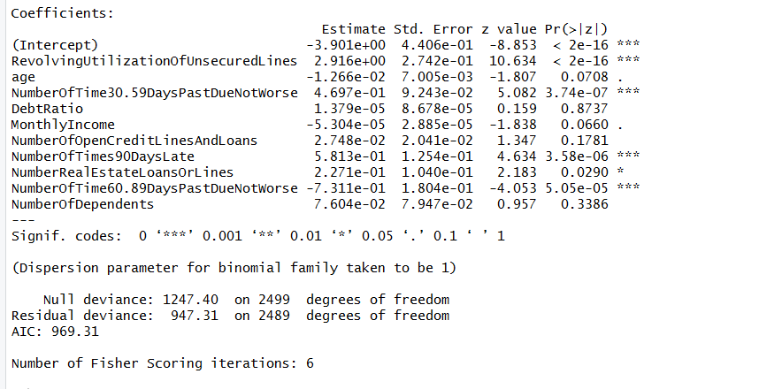
Results of Logistic Regression:
With glm function ran logistic regression
The variable with ‘’’***’ means these variable are significance and have higher effect on dependent variable.

Slide 10
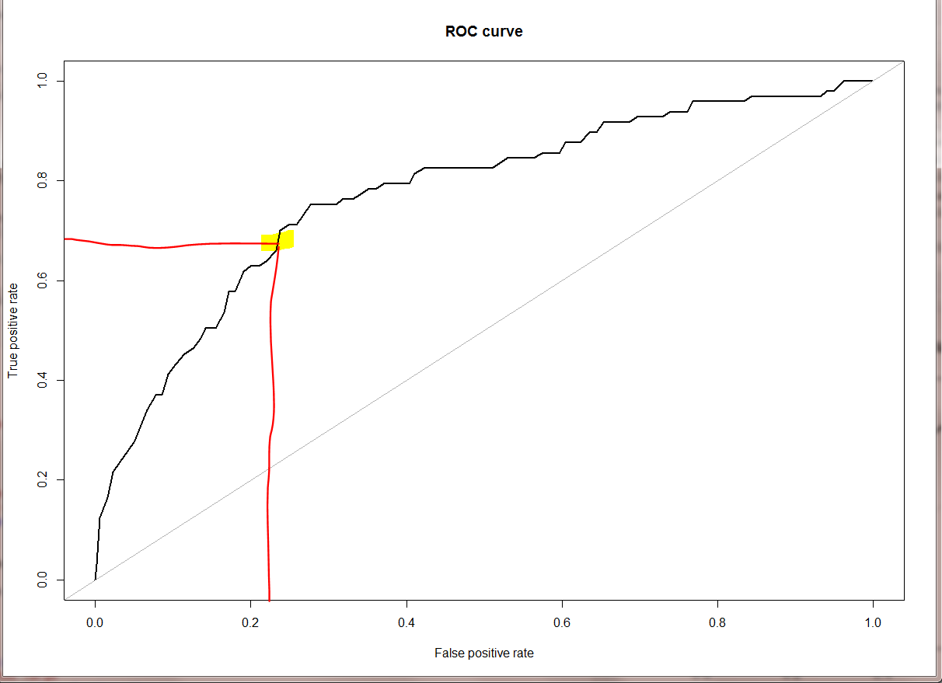
ROC curve:
To see True positive rate and false positive rate.
As we got Area under the curver value =0.773 which means that by using this model, by dropping 77% of bad customer we will drop 23% of good customers too.

Slide 11
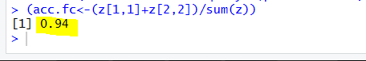
To check Accuracy:
To check accuracy through confusion matrix ,accuracy of this model is 94% which is pretty good

Slide 12
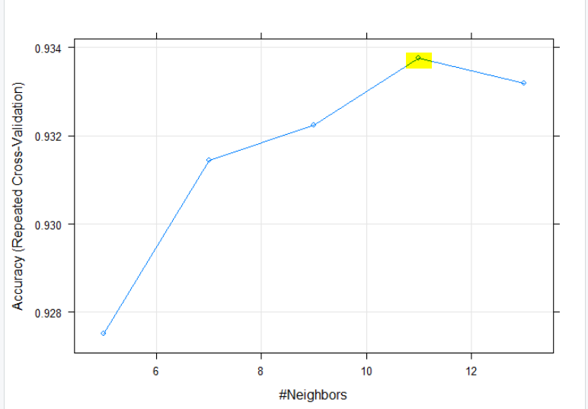
KNN method:
Used KNN method on training set.
Preprocess = center and scale
To control the overfitting value for Fold=5(usually we take odd values)
The Accuracy was used to select the model. As we can see in the graph value of k is 11 where accuracy is high.(0.9337588)

Slide 13
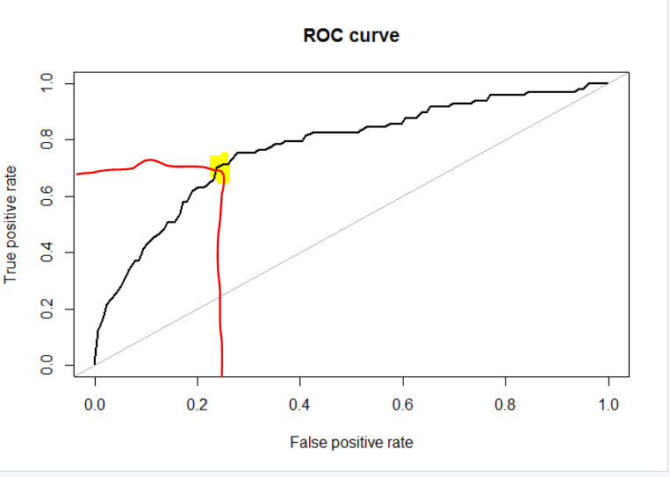
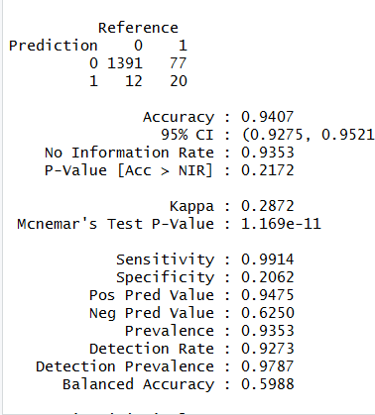
KNN method:
The Area under the curve (AUC) value for KNN mode is 0.773 which is close to logistic regression model.
It shows that both models accuracy is very close.
I decided it choose KNN model as its accuracy is 0.9047

Slide 14
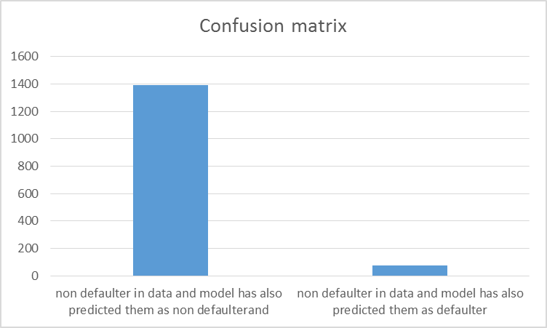
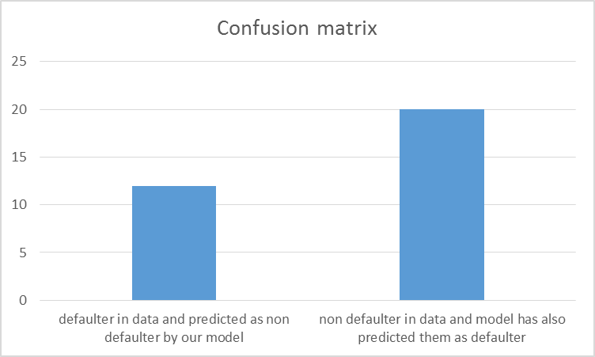
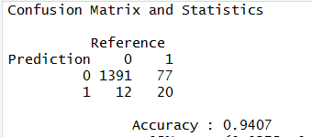
Final Results:
We have 1391 customer who are non defaulter in data and our model has also predicted them as non defaulters.
There are 77 customers who were non defaulter in data and were predicted as defaulter by our model.
Where as there were 12 customers who were defaulters in data and our model predicted them as non defaulters and 20 customers who are titled as defaulter by data and our model.

Slide 15


